Slide 1
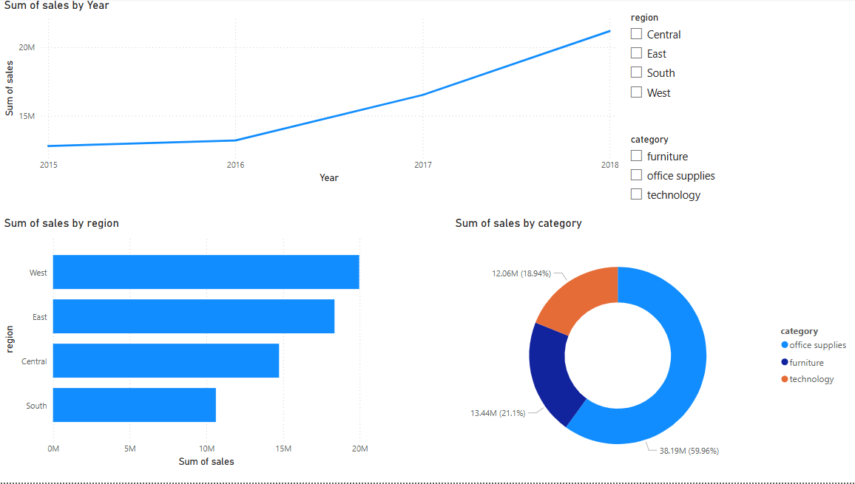

Slide 2
1. Line Chart – Sales Over Years
Insight:
Steady growth in sales from 2015 to 2018.
Significant jump between 2016 to 2017, indicating strong business expansion or seasonal spike.
The upward trend suggests consistent performance improvements year over year.
2. Bar Chart – Sales by Region
Insight:
West region leads in total sales, nearing 20M+, making it the top-performing region.
East and Central follow with strong numbers, while South lags behind with the lowest sales.
Strategic focus might be needed to boost performance in the South region.

Slide 3
3. Donut Chart – Sales by Category
Insight:
Office Supplies contribute the most to sales: ~60% of total – a dominant category.
Furniture follows with ~21%.
Technology has the smallest share (~19%), despite often having high-value items.
Slicer Impact
The Region and Category slicers allow users to dynamically analyze trends and performance per area or product type.
Great for targeted analysis – e.g., see how the West region performs in Technology vs. Office Supplies.

